Slide 1

What consumers value in top selling men’s athletic shoes and sneakers by brand
By: Sashank Gummella
TA: Stella Oliveira

Slide 2
Motivation
What do consumers of men’s athletic shoes and sneakers have to say about them?
Want to analyze which qualities consumers tend to base their purchasing decisions off of

Slide 3
Interest
Want to answer questions like:
- Which brands reign supreme in different ratings? Ex) Comfort, style
- What do consumers value in shoes? Ex) Price, arch support, true size feeling
- What are consumers saying about the shoes?
- Are there trends based on different shoe qualities?

Slide 4
Analysis
What was analyzed?
What was uncovered?

Slide 5
19 Unique Brands
 | Price($) | True Size Feeling | True Width Feeling | Arch Support | Comfort Rating | Style Rating | Overall Rating
Mean | 61.75 | 75.96 | 90.32 | 63.75 | 4.49 | 4.80 | 4.61
Std | 21.87 | 11.43 | 4.84 | 6.90 | 0.91 | 0.58 | 0.85
Min | 37.20 | 39 | 67.00 | 55.00 | 1.00 | 1.00 | 1.00
25% | 49.95 | 66 | 89.00 | 59.00 | 4.00 | 5.00 | 5.00
50% | 54.99 | 81 | 92.00 | 60.00 | 5.00 | 5.00 | 5.00
75% | 64.99 | 87 | 92.00 | 68.00 | 5.00 | 5.00 | 5.00
Max | 180.00 | 94 | 97.00 | 84.00 | 5.00 | 5.00 | 5.00

Slide 6
19 Unique Brands
Top 5 Selling Brands: (in order)
1. Converse
2. Vans
3. Onitsuka Tiger
4. Nike
5. Saucony Originals
Top 5 Selling Products: (in order)
1. Chuck Taylor All Star Core Ox [Converse]
2. Classic Slip-on Core Classics [Vans]
3. Ultimate 81 [Onitsuka Tiger]
4. Chuck Taylor All Star Core Hi [Converse]
5. Classic Slip-On [Vans]

Slide 7
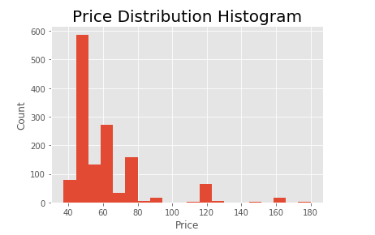

Slide 8
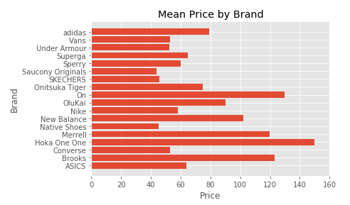
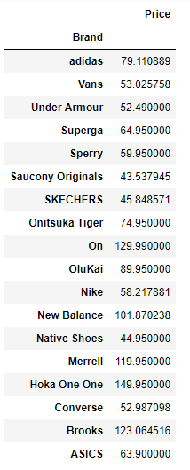

Slide 9
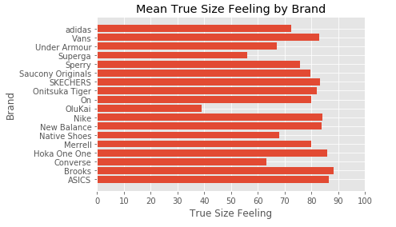
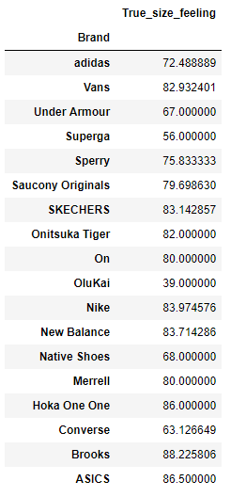

Slide 10
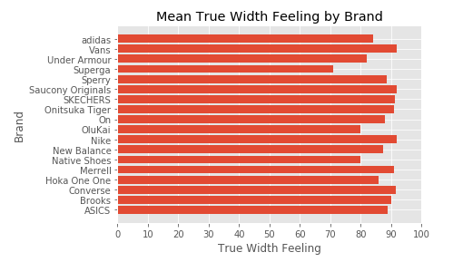
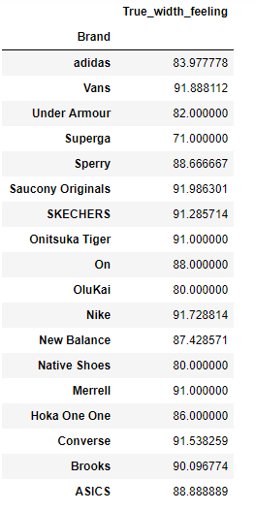

Slide 11
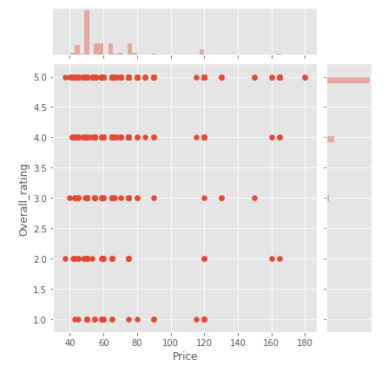
Overall Rating vs Price
Brand | Min | Max | Mean | Std
Converse | 1.000 | 5.000 | 4.728 | 0.680
Nike | 1.000 | 5.000 | 4.407 | 1.119
Onit. Tuska | 1.000 | 5.000 | 4.624 | 0.769
Saucony | 1.000 | 5.000 | 4.548 | 0.851
Vans | 1.000 | 5.000 | 4.660 | 0.812

Slide 12
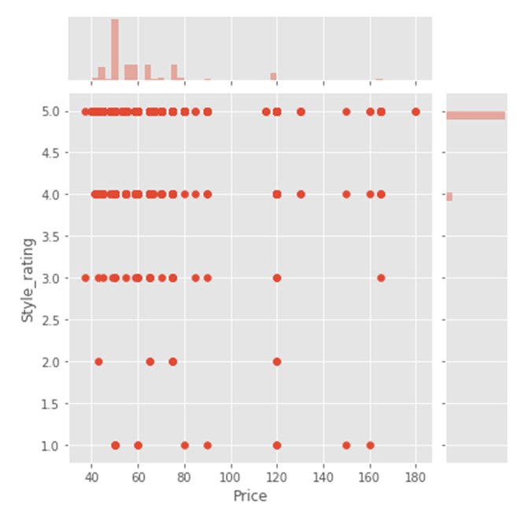
Style vs Price
Brand | Min | Max | Mean | Std
Converse | 2.000 | 5.000 | 4.902 | 0.361
Nike | 1.000 | 5.000 | 4.669 | 0.717
Onit. Tiger | 2.000 | 5.000 | 4.784 | 0.617
Saucony | 2.000 | 5.000 | 4.726 | 0.559
Vans | 1.000 | 5.000 | 4.850 | 0.539

Slide 13
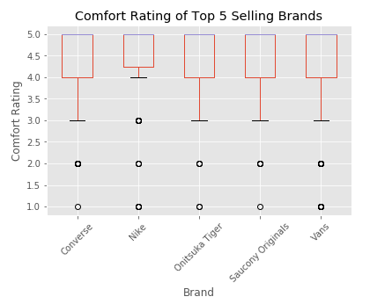
Comfort vs Price
Brand | Min | Max | Mean | Std
Converse | 1.000 | 5.000 | 4.488 | 0.814
Nike | 1.000 | 5.000 | 4.534 | 0.967
Onit. Tiger | 1.000 | 5.000 | 4.488 | 0.876
Saucony | 1.000 | 5.000 | 4.506 | 0.930
Vans | 1.000 | 5.000 | 4.506 | 0.906

Slide 14
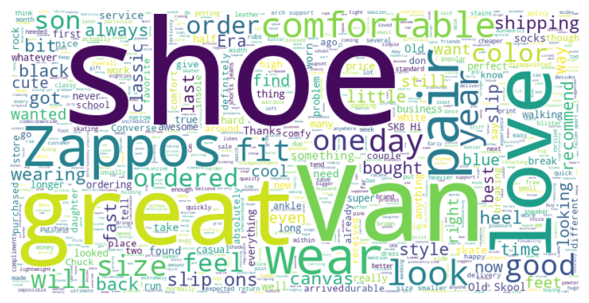
Vans

Slide 15
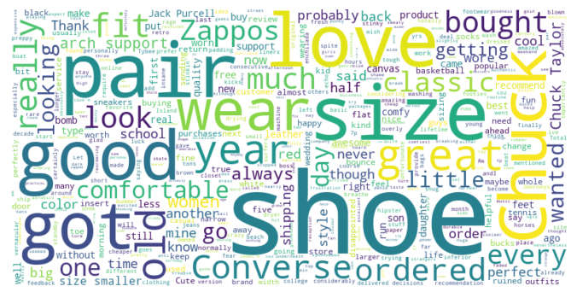
Converse

Slide 16
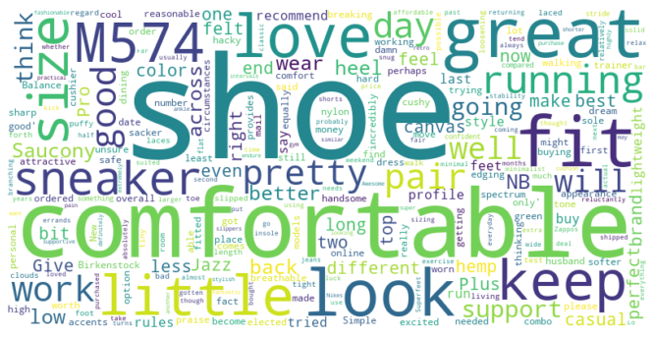
Saucony

Slide 17


Recap
People love a timeless look. Converse has that classic feel that transcends time.
Affordability and style seem to be frontrunners in consumer decision making.
Sneakers in the price range of $40-60 sell.
Try focusing more on improving comfort.
Athletic shoes have better true fit. Leisure shoes rank higher in style. “Ath-leisure” craze makes sense.

Slide 18
Future Work
If I had more time, data…
- Explore a connection between best selling products and social media influencers
- Perform sentiment analysis on more WordClouds

Slide 19
Thanks. Any Questions?

